Slide 1
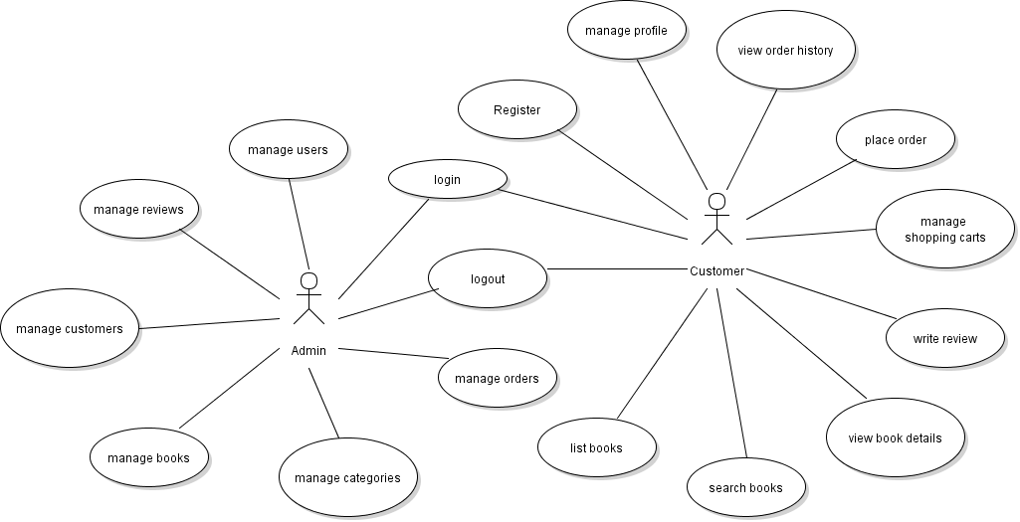
Code Review Management Module

Slide 2
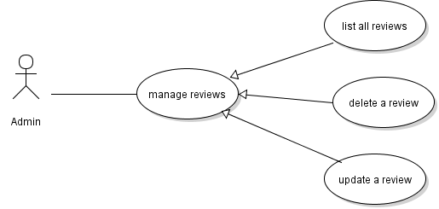
Review Management Use Cases

Slide 3
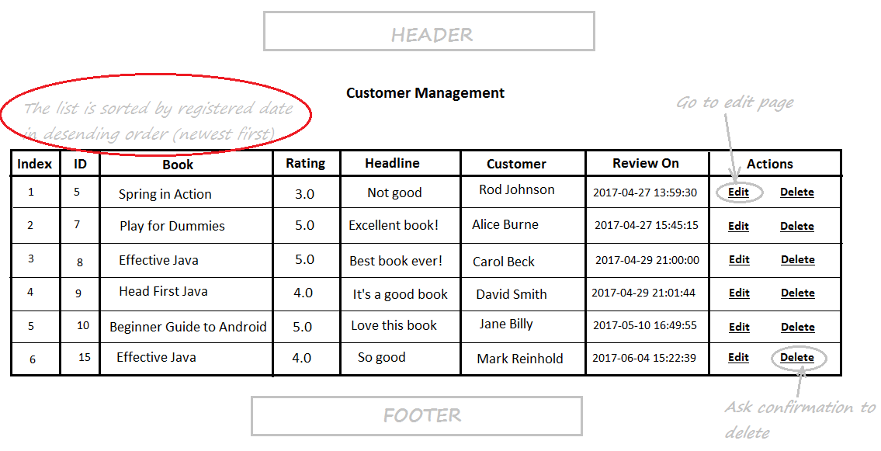
Review List Page

Slide 4
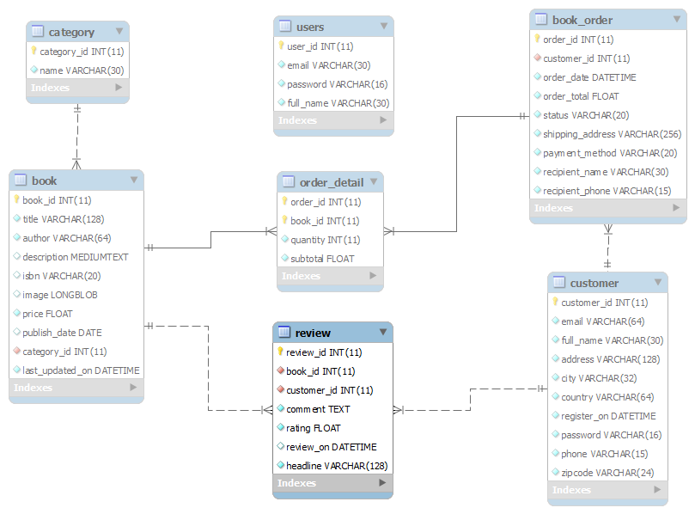
Database Design – Table review

Slide 5
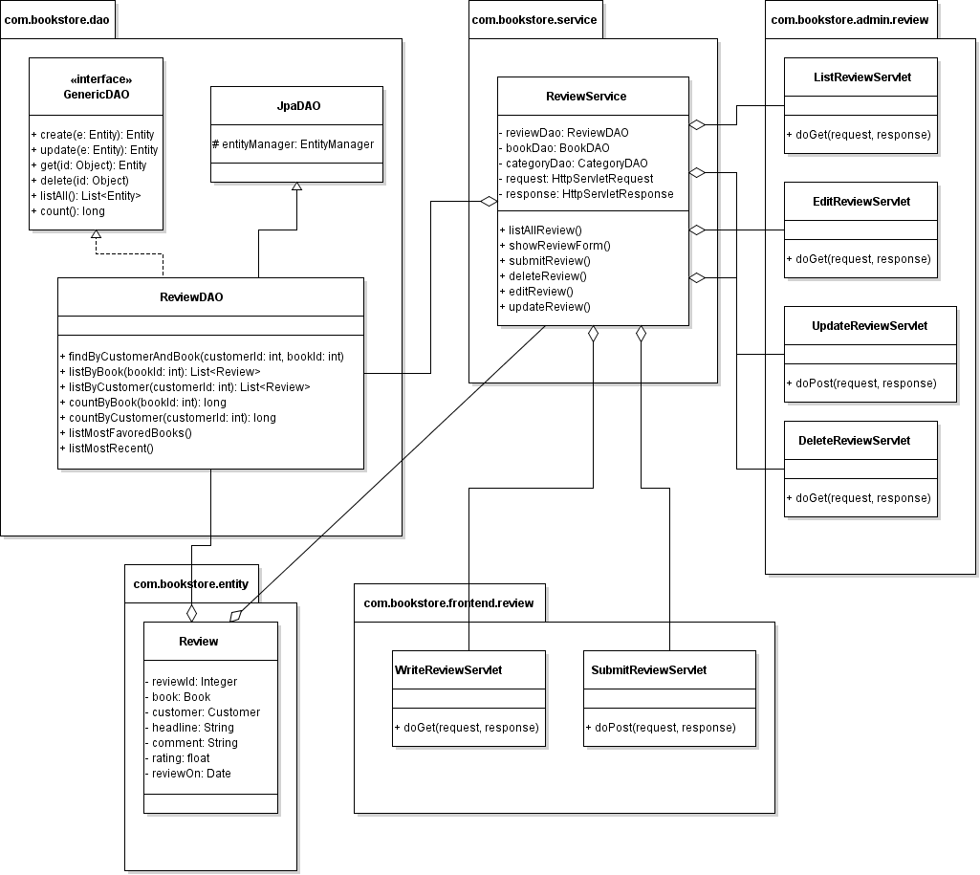
Class Diagram

Slide 6
Code Review Management Module
Task List:
Code ReviewDAO + Unit tests
Implement List Reviews feature
Implement Update Review feature
Implement Delete Review feature

Slide 7
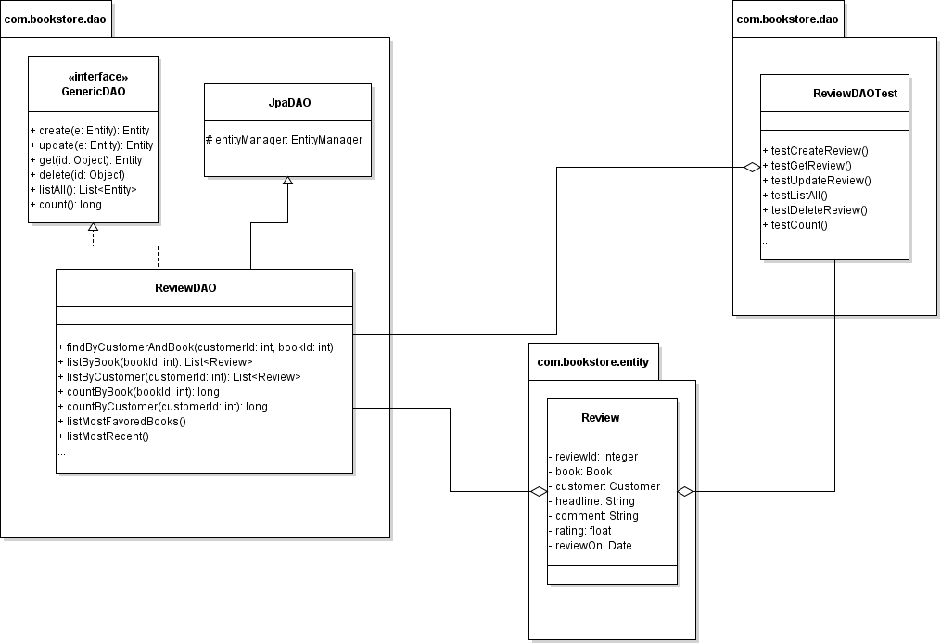
Code ReviewDAO

Slide 8
Implement List Reviews feature

Slide 9
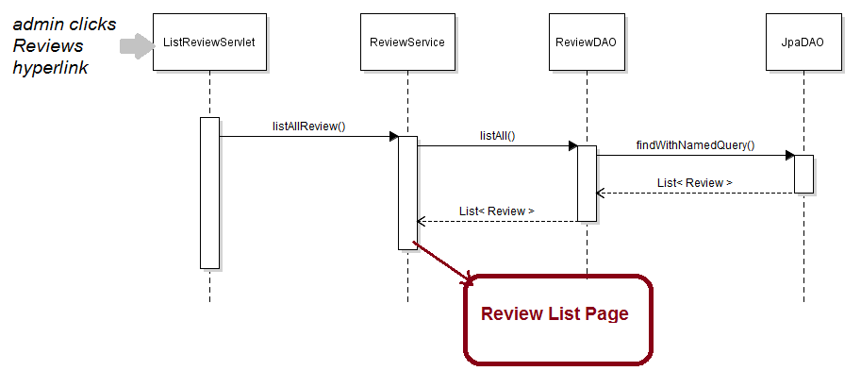
List Reviews Sequence Diagram

Slide 10
Implement List Reviews feature
Code ListReviewServlet
Code ReviewServices
Code Review List Page (HTML + JSTL)

Slide 11
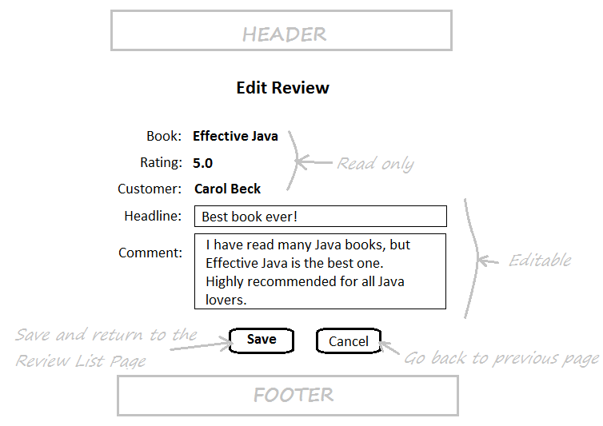
Review Form in Edit mode

Slide 12
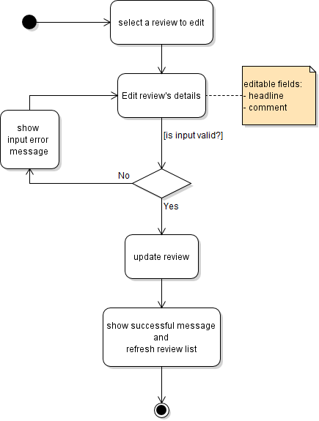
Activity Diagram: Update Review

Slide 13
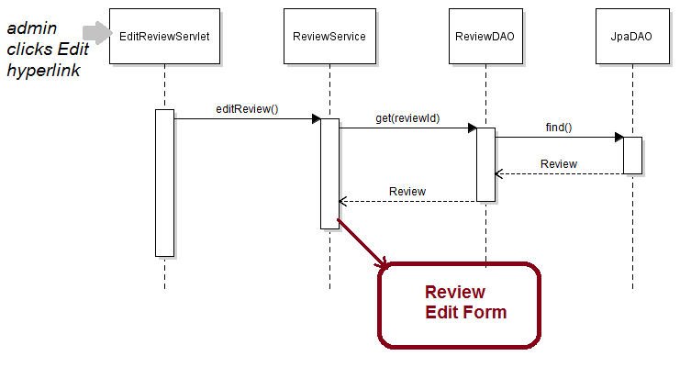
Sequence Diagram: Edit Review

Slide 14
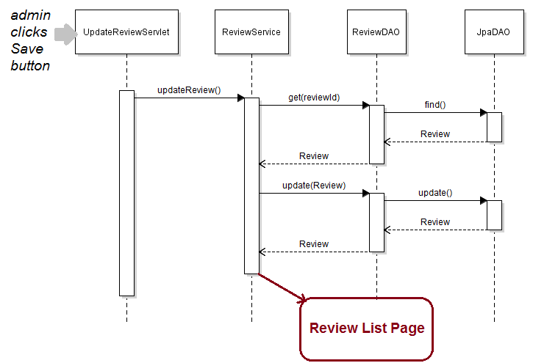
Sequence Diagram: Update Review

Slide 15
Class Diagram

Slide 16
Implement Update Review Feature
Create EditReviewServlet Class
Update Review Form Page (JSP)
Create UpdateReviewServlet
Update ReviewServices Class

Slide 17
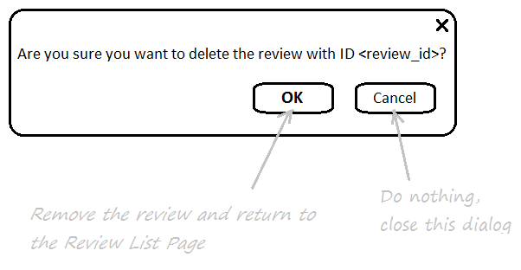
Implement Delete Review Feature

Slide 18
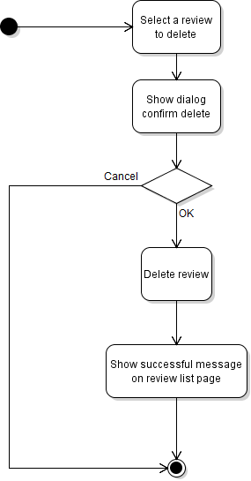
Activity Diagram: Delete Review

Slide 19
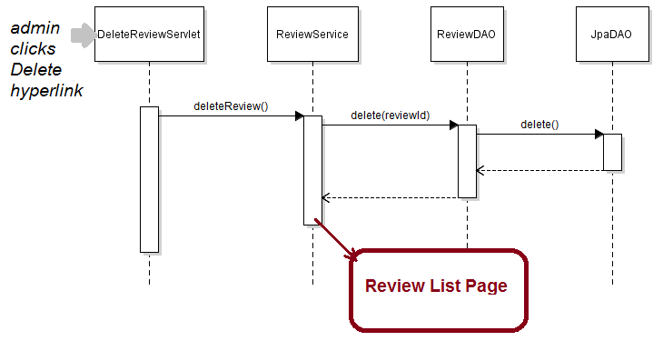
Sequence Diagram: Delete Review

Slide 20
Class Diagram

Slide 21
Implement Delete Review Feature
Show Delete Confirmation Dialog
Create DeleteReviewServlet
Update ReviewServices Class

